Slide 1
Topics
PL/SQL review
Iteration Statements
Cursors

Slide 2
PL/SQL Review
How is a SELECT used in a procedure?
SELECT column_list
INTO variable_list
FROM table_name
WHERE condition(s);
What are the possible exceptions you can monitor for?
An exception will occur if the SELECT statement returns more than one row.
TOO_MANY_ROWS exception
An exception will occur if the SELECT statement returns no data
NO_DATA_FOUND exception

Slide 3
PL/SQL Review
To find out how many rows are affected by DML statements, you can check the value of?
SQL%ROWCOUNT
Rewriting the Remove_Employees procedure with an update procedure
All empoyees of a particular year get a set commission

Slide 4
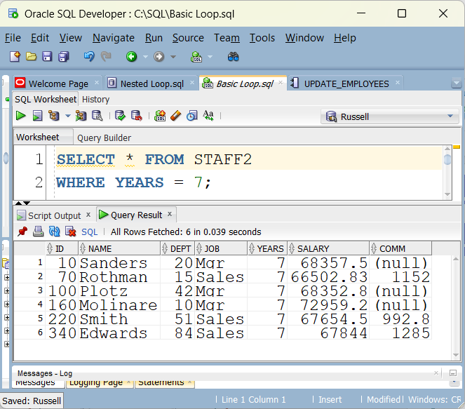

Slide 5
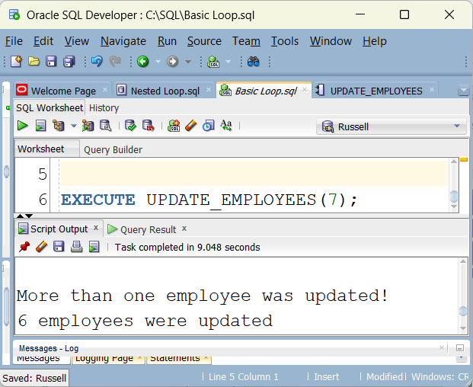

Slide 6
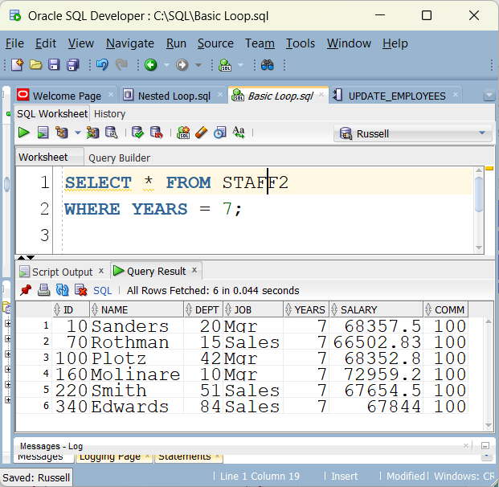

Slide 7
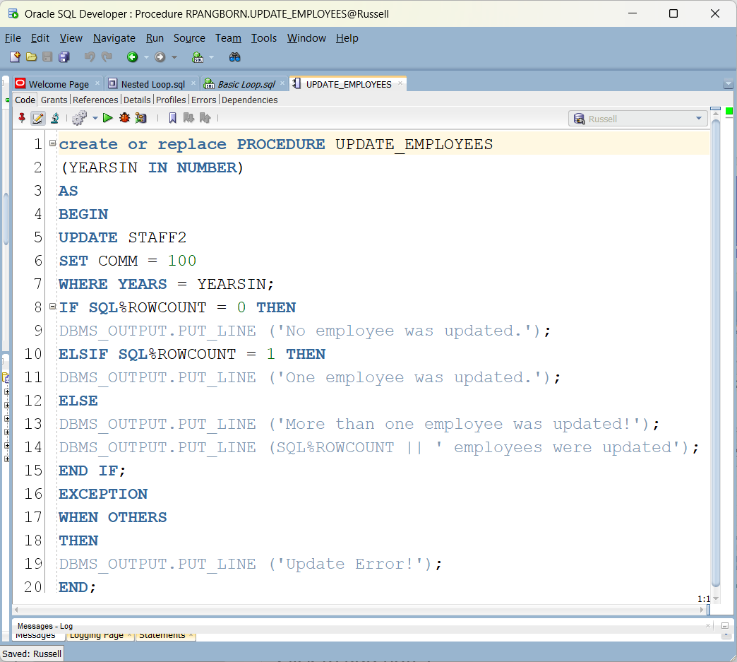

Slide 8
Iteration Statements
A LOOP statement runs a series of statements multiple times.
Basic LOOP
FOR LOOP
Cursor FOR LOOP
WHILE LOOP
Statements to exit a loop:
EXIT
EXIT WHEN

Slide 9
Iteration Statements
The statements that exit the current iteration of a loop and skip to the next iteration.
CONTINUE
CONTINUE WHEN

Slide 10
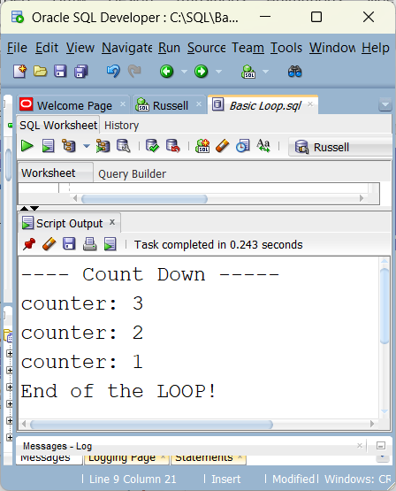
Basic LOOP Statements
The loop executes the statements until an EXIT statement terminates the loop execution or an exception is raised.
The EXIT statement terminates the loop and transfers the control to the end of the current loop.
DECLARE
counter NUMBER := 3;
BEGIN
DBMS_OUTPUT.PUT_LINE ('---- Count Down -----’);
LOOP
DBMS_OUTPUT.PUT_LINE ('counter: ' || counter);
counter := counter - 1;
IF counter < 1 THEN
EXIT;
END IF;
END LOOP;
DBMS_OUTPUT.PUT_LINE('End of the LOOP!');
END;

Slide 11
EXIT WHEN Statement
DECLARE
counter NUMBER := 3;
BEGIN
DBMS_OUTPUT.PUT_LINE ('---- Count Down -----’);
LOOP
DBMS_OUTPUT.PUT_LINE ('counter: ' || counter);
counter := counter - 1;
EXIT WHEN counter < 1;
END LOOP;
DBMS_OUTPUT.PUT_LINE('End of the LOOP!’);
END;

Slide 12
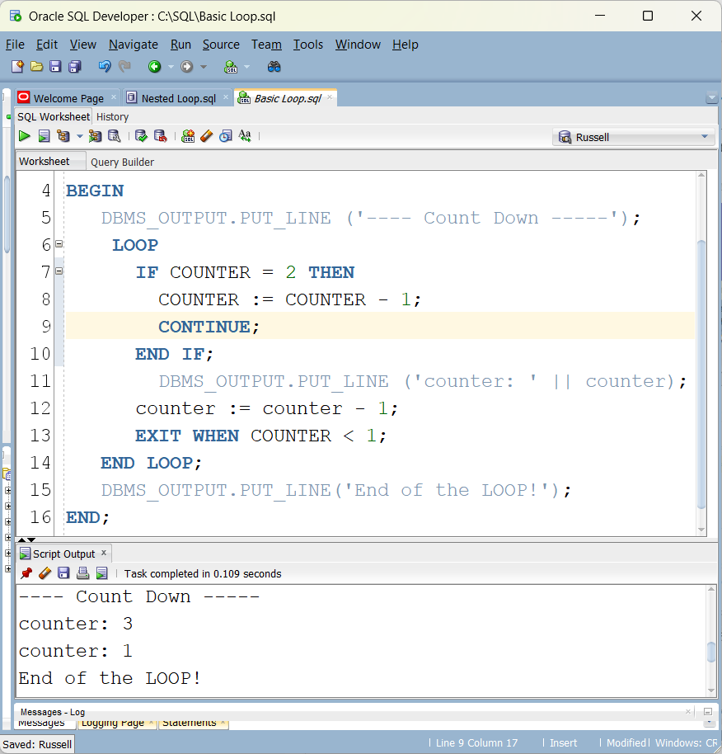
CONTINUE Statement
The CONTINUE statement exits the current iteration of the loop and goes to the next iteration.
The following code does not output value 2 for the variable counter.

Slide 13
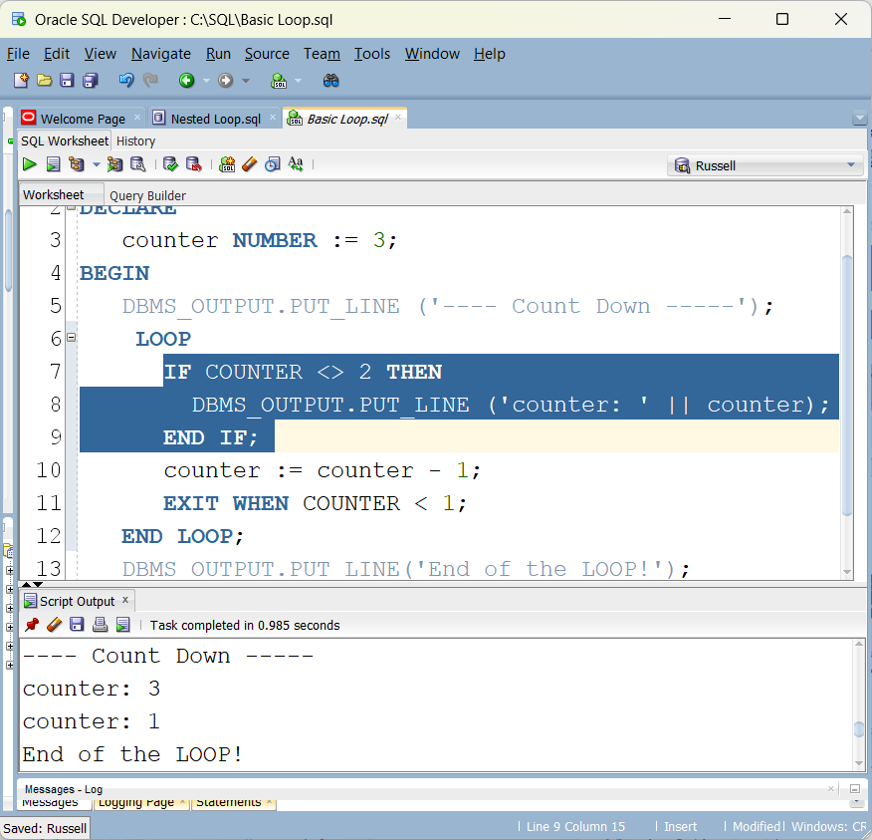
Avoiding use of Continue

Slide 14
A LOOP statement can be inside another LOOP statement. The EXIT statement inside the inner LOOP exits the inner LOOP and transfers the control to the outer loop.

Slide 15
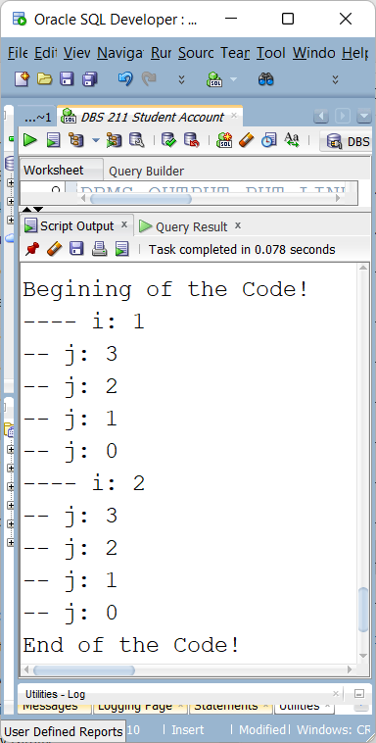
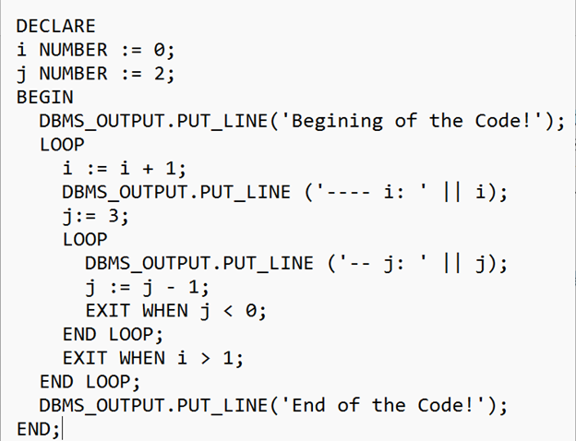
Nested Loop

Slide 16

FOR LOOP Statement
The FOR LOOP statement executes the statements inside the loop while the value of the loop index is in a given range.
By default, the value of the index starts from the lower bound value and increases by one until it becomes equal to the upper bound value.
IF you include the REVERSE keyword, the value of index starts from the upper bound value and deceases by one until it becomes equal to the lower bound value.
The upper bound value must be greater than or equal to the lower bound value.
Index is the local variable of the FOR loop.

Slide 17
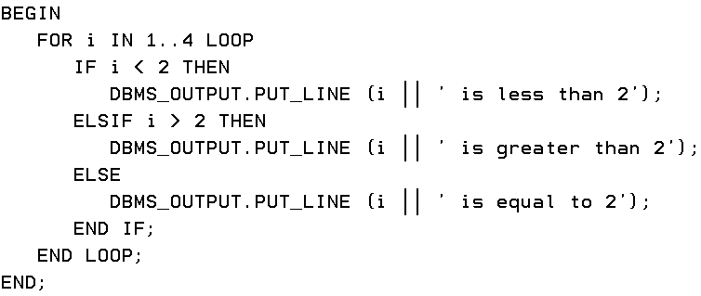
FOR LOOP Example
Output
1 is less than 2
2 is equal to 2
3 is greater than 2
4 is greater than 2

Slide 18
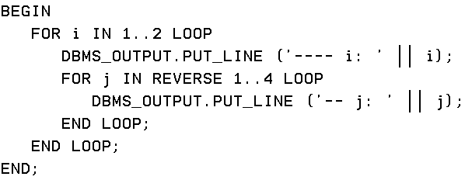
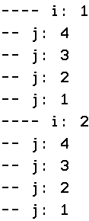
Nested FOR LOOP Statements
A FOR LOOP (inner loop) statement can be inside another FOR LOOP (outer loop). The inner loop executes until the its index reaches the terminating value or an EXIT statement is executed. The control then will be given to the outer FOR loop.

Slide 19

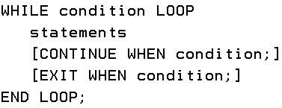
WHILE LOOP Statement
The WHILE loop executes the statements inside the loop as long as the loop condition is true. If the loop condition is false or an EXIT statement is executed, the control will be transferred to the next statement after the WHILE loop.
EXIT, EXIT WHEN, CONTINUE, or CONTINUE WHEN statements can be used inside a WHILE loop to terminate the current loop or the current iteration early.

Slide 20
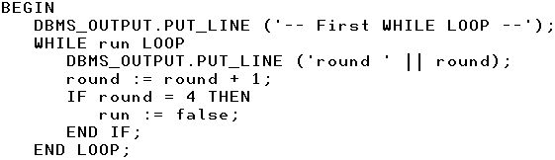
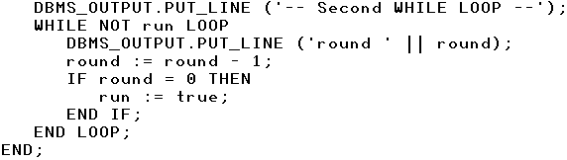
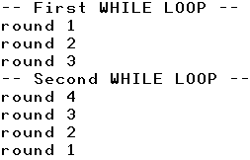
WHILE LOOP Example
DECLARE
run BOOLEAN := true;
round NUMBER := 1;

Slide 21
CURSORS
Cursors are used to process multiple rows in PL/SQL blocks.
In this course, we learn basic fundamentals about cursors. We use cursors to return multiple rows from a PL/SQL procedure to a caller procedure or program.
A cursor is a pointer to a context area that includes the result of a processed SQL statement. Simply, a cursor contains the rows of a select statement.
In PL/SQL, cursors are used to access and process the rows returned by a SELECT statement.
There are two types of cursors:
Implicit cursors
Explicit cursors

Slide 22
Implicit Cursors
The implicit cursors are automatically created while a statement such as INSERT, UPDATE, DELETE, and SELECT are executed.
The implicit cursor attributes can be used to determine if any rows have been affected as a result of the execution of a SQL statement.
In PL/SQL, the SELECT INTO statement, the implicit cursor can be evaluated to see if any row is returned.

Slide 23
Implicit Cursors
Attributes | Description
SQL%FOUND | It returns true if at least one row is affected by the execution of a DML or a SELECT statement
SQL%NOTFOUND | It returns true if no row is affected by the execution of a DML or a SELECT statement
SQL%ROWCOUNT | It returns the number of rows affected by the execution of a DML statement or a SELECT statement
SQL%ISOPEN | SQL%ISOPEN always has the value FALSE.

Slide 24
Explicit Cursors
The explicit cursors are defined in the declaration section of a PL/SQL block by programmers. It is used to process the multi-row results from a SELECT statement.
To define cursor:
CURSOR cursor_name IS select_statement;
To an explicit cursor in a PL/SQL block:
Declare the cursor
The memory is allocated for the cursor
Open the cursor
Retrieve data from the cursor
Close the cursor
The memory allocated to the cursor is released.

Slide 25
Explicit Cursors - DECLARE
Cursors can be defined in the declaration section.
CURSOR cursor_name IS select_statement;
DECLARE
CURSOR cursor_1 IS
SELECT last_name, job_title FROM employees
WHERE job_title LIKE ‘VP%’
ORDER BY last_name;
After the cursor is opened and a temporary table is loaded, you want to fetch the row column data a row at a time and put it into your appropriate variables.
You can use %type to pick up the same definition for your variable that is used in the original table column

Slide 26
Open a Cursor
You open and use the cursor in the executable section.
DECLARE
e_last_name employees.lastname%type;
e_job_title employees.jobtitle%type;
CURSOR emp_cursor IS
SELECT lastname, jobtitle
FROM employees
WHERE jobtitle LIKE ‘VP%’
ORDER BY lastname;
BEGIN
OPEN emp_cursor;

Slide 27
Fetching Data using a Cursor
In the executable section, you can fetch data from a cursor row by row in a loop.
FETCH cursor_name INTO variable_list;
BEGIN
OPEN emp_cursor;
LOOP
FETCH emp_cursor into e_last_name, e_job_title;
EXIT WHEN emp_cursor%notfound;
dbms_output.put_line(e_last_name || ' ' || e_job_title);
END LOOP;

Slide 28
Close a Cursor
You close a cursor in the executable section.
BEGIN
OPEN emp_cursor;
LOOP
FETCH emp_cursor into e_last_name, e_job_title;
EXIT WHEN emp_cursor%notfound;
dbms_output.put_line(e_last_name || ' ' || e_job_title);
END LOOP;
CLOSE emp_cursor;
END;

Slide 29
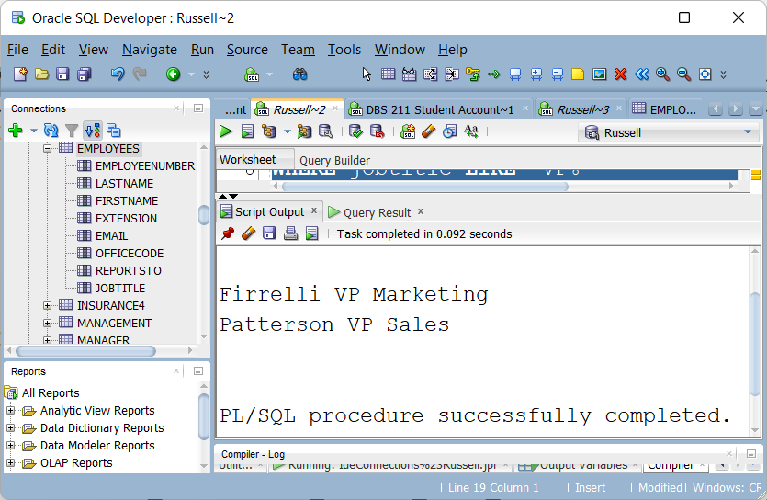
Executing the Cursor Code

Slide 30
Explicit Cursor with Parameters
You can pass parameters that affect what rows are returned when the cursor is opened.
If you want to return all products with prices between two prices, you can pass an upper and lower price
The following anonymous block has hard coded 115 and 120 as the upper and lower price to be used by the cursor

Slide 31
%Type
When you use %type, you do not have to know the definition of a column in a table when setting up your variable.
Also, if the type definition for that column changes, your code does not have to be updated – it will automatically pick up the new type definition

Slide 32
Explicit Cursor with Parameters
Can a cursor be flexible, by accepting different parameters each time it is used?
We have a PRODUCTS table with MSRP amounts.
One time we can have a temporary result table with prices between 115 and 120
Another time that cursor will produce a temporary result table with prices between 60 and 80

Slide 33
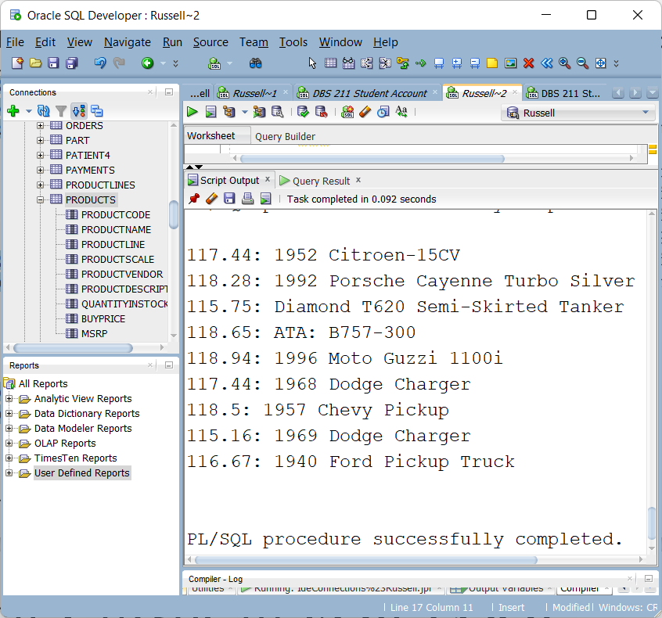
Explicit Cursor with Parameters

Slide 34
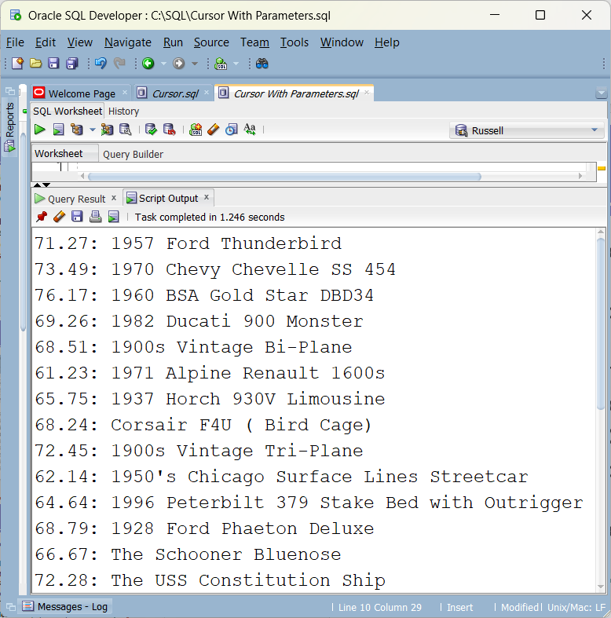
Explicit Cursor with Parameters

Slide 35
%Rowtype
Used to pull in the column type definitions for an entire row of a table
variable_name table_or_view_name%ROWTYPE;
For every column of the table or view, the record has a field with the same name and data type.
PRODUCTS has ProductName, MSRP
p_product PRODUCTS%ROWTYPE
We now have variables called p_product.productname and p_product.msrp
Which can be loaded from the table’s ProductName and MSRP columns and the column types match

Slide 36
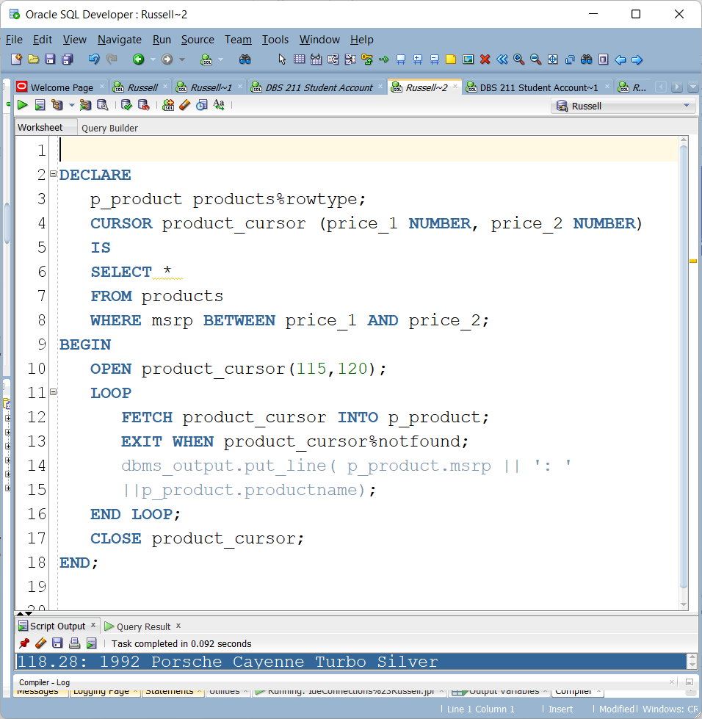
Explicit Cursor with Parameters

Slide 37
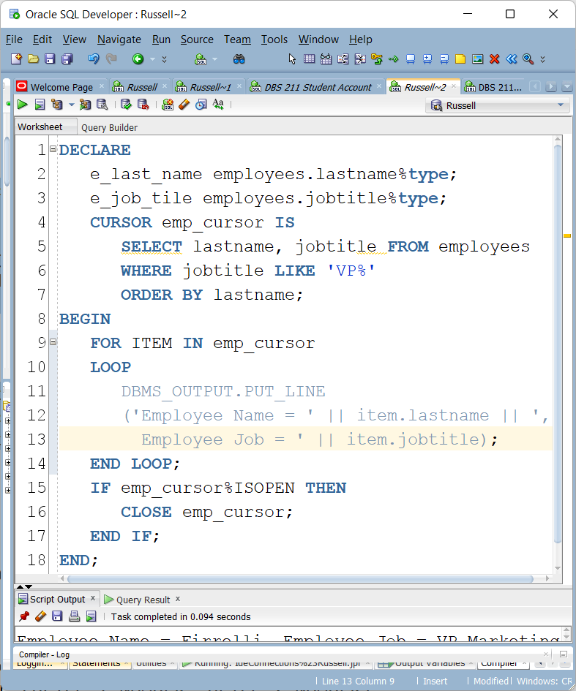
Explicit Cursor in FOR LOOP
The FOR LOOP statement, opens the explicit cursor. When you use a FOR LOOP statement, there is no need to open and close the cursor.

Slide 38
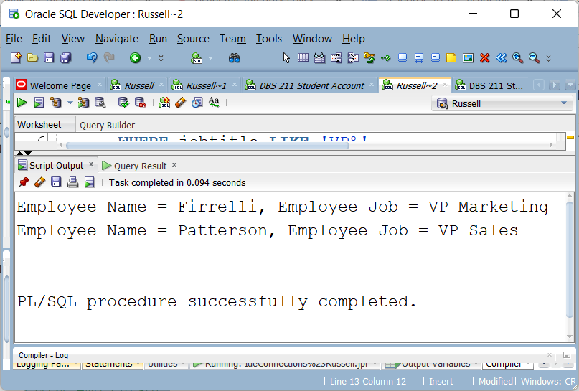
Explicit Cursor in FOR LOOP

Slide 39
Explicit Cursor Attributes
Attributes | Description
%FOUND | INVALID_CURSOR: if the cursor is not open NULL: before we fetch the first row FALSE: if no row is fetched successfully TRUE: if the row is fetched successfully
%NOTFOUND | INVALID_CURSOR: if the cursor is not open. NULL: before we fetch the first row
%ROWCOUNT | INVALID_CURSOR: if the cursor is not open Otherwise: It returns the number of rows returned from the cursor
%ISOPEN | TRUE: if the cursor is open FALSE: if the cursor is not open

Slide 40
%RowCount
CursorName%RowCount
Cursors do not know how many rows there are when the cursor is opened
The count is incremented with each successful Fetch
You can use this feature within a loop while fetching rows or after the loop is finished to report on total rows fetched

Slide 41
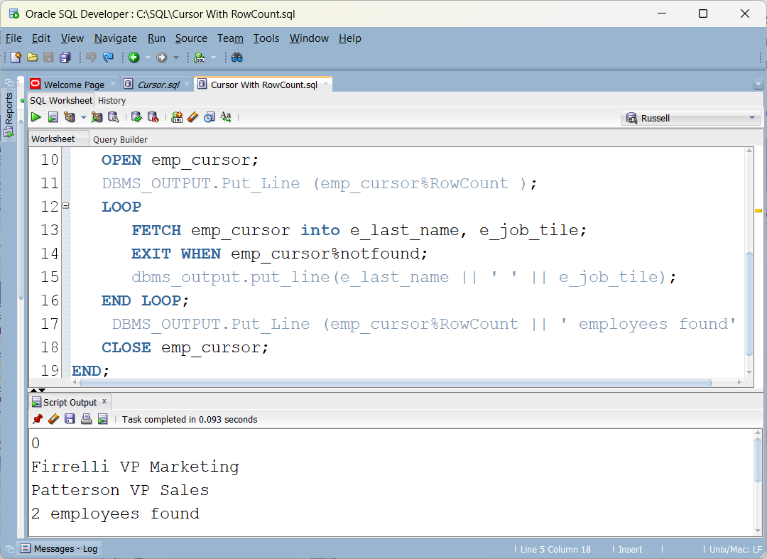
%RowCount

Slide 42
Lab 6
Lab 5 is due online this week
Zoom link sent out at start of this week’s lab
Lab 6 has been posted as an Oracle lab

